Slide 1
Data Science Bootcamp –
NLP – Sentiment Analysis
Shovon Sengupta

Slide 2
Overview:
Overview – Sentiment Analysis
“How long has it been since you last posted to Facebook, Twitter, Reddit or Quora? Maybe you’re checking your Instagram right now. Well, you may not think about it this way very often, but you’re feeding Web 2.0, which in turn is giving rise to a revolutionary new method of decision making based on the content posted online by billions of users.”
Sentiment analysis is the process by which all that content can be quantified to represent the ideas, beliefs and opinions of entire sectors of the public. The implications are difficult to understate.
The problem at hand is sentiment analysis or opinion mining, where we want to analyze some textual documents and predict their sentiment or opinion based on the content of these documents. Sentiment analysis is perhaps one of the most popular applications of natural language processing and text analytics with a vast number of websites, books and tutorials on this subject. Typically sentiment analysis seems to work best on subjective
text, where people express opinions, feelings, and their mood. From a real-world industry standpoint, sentiment analysis is widely used to analyze corporate surveys, feedback surveys, social media data, and reviews for movies, places, commodities, and many more. The idea is to analyze and understand the reactions of people toward a specific entity and take insightful actions based on their sentiment.
A text corpus consists of multiple text documents and each document can be as simple as a single sentence to a complete document with multiple paragraphs. Textual data, in spite of being highly unstructured, can be classified into two major types of documents. Factual documents that typically depict some form of statements or facts with no specific feelings or emotion attached to them. These are also known as objective documents. Subjective documents on the other hand have text that expresses feelings, moods, emotions, and opinions.
Sentiment analysis is also popularly known as opinion analysis or opinion mining. The key idea is to use techniques from text analytics, NLP, Machine Learning, and linguistics to extract important information or data points from unstructured text. This in turn can help us derive qualitative outputs like the overall sentiment being on a positive, neutral, or negative scale and quantitative outputs like the sentiment polarity, subjectivity, and objectivity proportions. Sentiment polarity is typically a numeric score that’s assigned to both the positive and negative aspects of a text document based on subjective parameters like specific words and phrases expressing feelings and emotion. Neutral sentiment typically has 0 polarity since it does not
express and specific sentiment, positive sentiment will have polarity > 0, and negative < 0. Of course, you can always change these thresholds based on the type of text you are dealing with; there are no hard constraints on this.

Slide 3
Objective:
Sentiment Analysis – Objective
We focus on trying to analyze a large corpus of movie reviews and derive the sentiment. We cover a wide variety of techniques for analyzing sentiment, which include the following.
Unsupervised lexicon-based models.
Traditional supervised Machine Learning models
Newer supervised Deep Learning models
Newer supervised Deep Learning models
Besides looking at various approaches and models, we also focus on important aspects in the Machine Learning pipeline including text pre processing, normalization, and in-depth analysis of models, including model interpretation and topic models. The key idea here is to understand how we tackle a problem like sentiment analysis on unstructured text, learn various techniques, models and understand how to interpret the results. This will enable you to use these methodologies in the future on your own datasets. Let’s get started!
Problem Statement:
The main objective in this chapter is to predict the sentiment for a number of movie reviews obtained from the Internet Movie Database (IMDb). This dataset contains 50,000 movie reviews that have been pre-labeled with “positive” and “negative” sentiment class labels based on the review content. Besides this, there are additional movie reviews that are unlabeled. The dataset can be obtained from http://ai.stanford.edu/~amaas/data/sentiment/, courtesy of Stanford University and Andrew L. Maas, Raymond E. Daly, Peter T. Pham, Dan Huang, Andrew Y. Ng, and Christopher Potts. This dataset was also used in their famous paper, Learning Word Vectors for Sentiment Analysis proceedings of the 49th Annual Meeting of the Association for Computational Linguistics (ACL 2011). They have datasets in the form of raw text as well as already processed bag of words formats. We will only be using the raw labeled movie reviews for our analyses in this chapter. Hence our task will be to predict the sentiment of 15,000 labeled movie reviews and use the remaining 35,000 reviews for training our supervised models. We will still predict sentiments for only 15,000 reviews in case of unsupervised models to maintain consistency and enable ease of comparison.

Slide 4
Basic processing of the text:
Text Pre-Processing and Normalization
One of the key steps before diving into the process of feature engineering and modeling involves cleaning, pre-processing, and normalizing text to bring text components like phrases and words to some standard format. This enables standardization across a document corpus, which helps build meaningful features and helps reduce noise that can be introduced due to many factors like irrelevant symbols, special characters, XML and HTML tags, and so on.
Major Steps:
Cleaning Text.
Removing accented characters.
Expanding contractions
Removing special characters.
Stemming and lemmatization
Removing Stopwords

Slide 5
Unsupervised Model – Explained:
Unsupervised Models
Unsupervised Lexicon-Based Models:
We have talked about unsupervised learning methods in the past, which refer to specific modeling methods that can be applied directly on data features without the presence of labeled data. One of the major challenges in any organization is getting labeled datasets due the lack of time as well as resources to do this tedious task. Unsupervised methods are very useful in this scenario and we will be looking at some of these methods in this section. Even though we have labeled data, this section should give you a good idea of how lexicon based models work and you can apply the same in your own datasets when you do not have labeled data.
Unsupervised sentiment analysis models use well curated knowledge bases, ontologies, lexicons, and databases that have detailed information pertaining to subjective words, phrases including sentiment, mood, polarity, objectivity, subjectivity, and so on. A lexicon model typically uses a lexicon, also known as a dictionary or vocabulary of words specifically aligned toward sentiment analysis. Usually these lexicons contain a list of words associated with positive and negative sentiment, polarity (magnitude of negative or positive score), parts of speech (POS) tags, subjectivity classifiers (strong, weak, neutral), mood, modality, and so on. You can use these lexicons and compute sentiment of a text document by matching the presence of specific words from the lexicon, look at other additional factors like presence of negation parameters, surrounding words, overall context and phrases and aggregate overall sentiment polarity scores to decide the final sentiment score. There are several popular lexicon models used for sentiment analysis. Some of them are mentioned as follows.
Bing Liu’s Lexicon
MPQA Subjectivity Lexicon
Pattern Lexicon
AFINN Lexicon
SentiWordNet Lexicon
VADER Lexicon
This is not an exhaustive list of lexicon models, but definitely lists among the most popular ones available today. We will be covering the last three lexicon models in more detail with hands-on code and examples using our movie review dataset. We will be using the last 15,000 reviews and predict their sentiment and see how well our model performs based on model evaluation metrics like accuracy, precision, recall, and F1-score. Since we have labeled data, it will be easy for us to see how well our actual sentiment values for these movie reviews match our lexicon model based predicted sentiment values.
Notes:
https:// www.cs.uic.edu/~liub/FBS/sentiment-analysis.html#lexicon
http://mpqa.cs.pitt.edu/lexicons/subj_lexicon/
https://github.com/clips/pattern/blob/master/pattern/text/en/en-sentiment.xml
https://github.com/fnielsen/afinn/blob/master/afinn/data/
http://sentiwordnet.isti.cnr.it
https://github.com/cjhutto/vaderSentiment

Slide 6
Lexicon Based Model – Explained:
Lexicon Based Model
Bing Liu’s Lexicon:
This lexicon contains over 6,800 words which have been divided into two files named positive-words.txt, containing around 2,000+ words/phrases and negative-words.txt, which contains 4,800+ words/phrases. The lexicon has been developed and curated by Bing Liu over several years and has also been explained in detail in his original paper by Nitin Jindal and Bing Liu, “Identifying Comparative Sentences in Text Documents” proceedings of the 29th Annual International ACM SIGIR, Seattle 2006. If you want to use this lexicon, you can get it from https:// www.cs.uic.edu/~liub/FBS/sentiment-analysis.html#lexicon, which also includes a link to download it as an archive (RAR format).
MPQA Subjectivity Lexicon: The term MPQA stands for Multi-Perspective Question Answering and it contains a diverse set of resources pertaining to opinion corpora, subjectivity lexicon, subjectivity sense annotations, argument lexicon, debate corpora, opinion finder, and many more. This is developed and maintained by the University of Pittsburgh and their official web site http://mpqa.cs.pitt.edu/ contains all the necessary information. The subjectivity lexicon is a part of their opinion finder framework and contains subjectivity clues and contextual polarity. Details on this can be found in the paper by Theresa Wilson, Janyce Wiebe, and Paul Hoffmann, “Recognizing Contextual Polarity in Phrase-Level Sentiment Analysis” proceeding of HLT-EMNLP-2005. You can download the subjectivity lexicon from their official web site at http://mpqa.cs.pitt.edu/lexicons/subj_lexicon/, contains subjectivity clues present in the dataset named subjclueslen1-HLTEMNLP05.tff.
Pattern Lexicon:
The pattern package is a complete natural language processing framework available in Python which can be used for text processing, sentiment analysis and more. This has been developed by CLiPS (Computational Linguistics & Psycholinguistics), a research center associated with the Linguistics Department of the Faculty of Arts of the University of Antwerp. Pattern uses its own sentiment module which internally uses a lexicon which you can access from their official GitHub repository at https://github.com/clips/pattern/blob/master/pattern/text/en/en-sentiment.xml and this contains the complete subjectivity based lexicon database.
Thus you get important metadata information like WordNet corpus identifiers, polarity scores, word sense, POS tags, intensity, subjectivity scores, and so on. These can in turn be used to compute sentiment over a text document based on polarity and subjectivity score. Unfortunately, pattern has still not been ported officially for Python 3.x and it works on Python 2.7.x. However, you can still load this lexicon and do your own modeling as needed.
Notes:
https:// www.cs.uic.edu/~liub/FBS/sentiment-analysis.html#lexicon
http://mpqa.cs.pitt.edu/lexicons/subj_lexicon/
https://github.com/clips/pattern/blob/master/pattern/text/en/en-sentiment.xml
https://github.com/fnielsen/afinn/blob/master/afinn/data/
http://sentiwordnet.isti.cnr.it
https://github.com/cjhutto/vaderSentiment

Slide 7
Lexicon Based Model – Explained:
Lexicon Based Model
Bing Liu’s Lexicon:
This lexicon contains over 6,800 words which have been divided into two files named positive-words.txt, containing around 2,000+ words/phrases and negative-words.txt, which contains 4,800+ words/phrases. The lexicon has been developed and curated by Bing Liu over several years and has also been explained in detail in his original paper by Nitin Jindal and Bing Liu, “Identifying Comparative Sentences in Text Documents” proceedings of the 29th Annual International ACM SIGIR, Seattle 2006. If you want to use this lexicon, you can get it from https:// www.cs.uic.edu/~liub/FBS/sentiment-analysis.html#lexicon, which also includes a link to download it as an archive (RAR format).
MPQA Subjectivity Lexicon: The term MPQA stands for Multi-Perspective Question Answering and it contains a diverse set of resources pertaining to opinion corpora, subjectivity lexicon, subjectivity sense annotations, argument lexicon, debate corpora, opinion finder, and many more. This is developed and maintained by the University of Pittsburgh and their official web site http://mpqa.cs.pitt.edu/ contains all the necessary information. The subjectivity lexicon is a part of their opinion finder framework and contains subjectivity clues and contextual polarity. Details on this can be found in the paper by Theresa Wilson, Janyce Wiebe, and Paul Hoffmann, “Recognizing Contextual Polarity in Phrase-Level Sentiment Analysis” proceeding of HLT-EMNLP-2005. You can download the subjectivity lexicon from their official web site at http://mpqa.cs.pitt.edu/lexicons/subj_lexicon/, contains subjectivity clues present in the dataset named subjclueslen1-HLTEMNLP05.tff.
Pattern Lexicon:
The pattern package is a complete natural language processing framework available in Python which can be used for text processing, sentiment analysis and more. This has been developed by CLiPS (Computational Linguistics & Psycholinguistics), a research center associated with the Linguistics Department of the Faculty of Arts of the University of Antwerp. Pattern uses its own sentiment module which internally uses a lexicon which you can access from their official GitHub repository at https://github.com/clips/pattern/blob/master/pattern/text/en/en-sentiment.xml and this contains the complete subjectivity based lexicon database.
Thus you get important metadata information like WordNet corpus identifiers, polarity scores, word sense, POS tags, intensity, subjectivity scores, and so on. These can in turn be used to compute sentiment over a text document based on polarity and subjectivity score. Unfortunately, pattern has still not been ported officially for Python 3.x and it works on Python 2.7.x. However, you can still load this lexicon and do your own modeling as needed.
Notes:
https:// www.cs.uic.edu/~liub/FBS/sentiment-analysis.html#lexicon
http://mpqa.cs.pitt.edu/lexicons/subj_lexicon/
https://github.com/clips/pattern/blob/master/pattern/text/en/en-sentiment.xml
https://github.com/fnielsen/afinn/blob/master/afinn/data/
http://sentiwordnet.isti.cnr.it
https://github.com/cjhutto/vaderSentiment

Slide 8
Lexicon Based Model – Explained:
Lexicon Based Model
AFINN Lexicon:
The AFINN lexicon is perhaps one of the simplest and most popular lexicons that can be used extensively for sentiment analysis. Developed and curated by Finn Årup Nielsen, you can find more details on this lexicon in the paper by Finn Årup Nielsen, “A new ANEW: evaluation of a word list for sentiment analysis in microblogs”, proceedings of the ESWC2011 Workshop. The current version of the lexicon is AFINN-en-165.txt and it contains over 3,300+ words with a polarity score associated with each word. You can find this lexicon at the author’s official GitHub repository along with previous versions of this lexicon including AFINN-111 at https://github.com/fnielsen/afinn/blob/master/afinn/data/. The author has also created a nice wrapper library on top of this in Python called afinn which we will be using for our analysis needs.
We can compare the actual sentiment label for each review and also check out the predicted sentiment polarity score. A negative polarity typically denotes negative sentiment. To predict sentiment on our complete test dataset of 15,000 reviews (I used the raw text documents because AFINN takes into account other aspects like emoticons and exclamations), we can now use the following snippet. I used a threshold of >= 1.0 to determine if the overall sentiment is positive else negative. You can choose your own threshold based on analyzing your own corpora in the future.
SentiWordNet Lexicon:
The WordNet corpus is definitely one of the most popular corpora for the English language used extensively in natural language processing and semantic analysis. WordNet gave us the concept of synsets or synonym sets. The SentiWordNet lexicon is based on WordNet synsets and can be used for sentiment analysis and opinion mining. The SentiWordNet lexicon typically assigns three sentiment scores for each WordNet synset. These include a positive polarity score, a negative polarity score and an objectivity score. Further details are available on the official web site http://sentiwordnet.isti.cnr.it, including research papers and download links for the lexicon. We will be using the nltk library, which provides a Pythonic interface into SentiWordNet.
VADER Lexicon:
The VADER lexicon, developed by C.J. Hutto, is a lexicon that is based on a rule-based sentiment analysis framework, specifically tuned to analyze sentiments in social media. VADER stands for Valence Aware Dictionary and Sentiment Reasoner. Details about this framework can be read in the original paper by Hutto,C.J. & Gilbert, E.E. (2014) titled “VADER: A Parsimonious Rule-based Model for Sentiment Analysis of Social Media Text”, proceedings of the Eighth International Conference on Weblogs and Social Media (ICWSM-14). You can use the library based on nltk's interface under the nltk.sentiment.vader module. Besides this, you can also download the actual lexicon or install the framework from https://github.com/cjhutto/VaderSentiment, which also contains detailed information about VADER. This lexicon, present in the file titled vader_lexicon.txt contains necessary sentiment scores associated with words, emoticons and slangs(like wtf, lol, nah, and so on). There were a total of over 9000 lexical features from which over 7500 curated lexical features were finally selected in the lexicon with proper validated valence scores. Each feature was rated on a scale from "[-4] Extremely Negative" to "[4] Extremely Positive", with allowance for "[0] Neutral (or Neither, N/A)". The process of selecting lexical features was done by keeping all features that had a non-zero mean rating and whose standard deviation was less than 2.5, which was determined by the aggregate of ten independent raters. We depict a sample from the VADER lexicon
Notes:
https:// www.cs.uic.edu/~liub/FBS/sentiment-analysis.html#lexicon
http://mpqa.cs.pitt.edu/lexicons/subj_lexicon/
https://github.com/clips/pattern/blob/master/pattern/text/en/en-sentiment.xml
https://github.com/fnielsen/afinn/blob/master/afinn/data/
http://sentiwordnet.isti.cnr.it
https://github.com/cjhutto/vaderSentiment

Slide 9
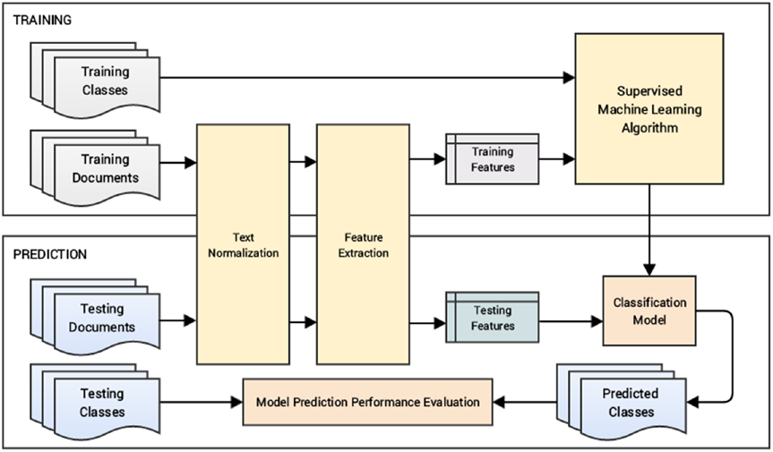
Support Vector Machine- Explained
Supervised Models
Supervised Models:
Another way to build a model to understand the text content and predict the sentiment of the text based reviews is to use supervised Machine
Learning. To be more specific, we will be using classification models for solving this problem. We have already covered the concepts relevant to supervised learning and classification in Chapter 1 under the section “Supervised Learning”. With regard to details on building and evaluating classification models, you can head over to Chapter 5 and refresh your memory if needed. We will be building an automated sentiment text classification system in subsequent sections. The major steps to achieve this are mentioned as follows.
Prepare train and test datasets (optionally a validation dataset)
Pre-process and normalize text documents
Feature engineering
Model training
Model prediction and evaluation
These are the major steps for building our system. Optionally the last step would be to deploy the model in your server or on the cloud. Figure 1 shows a detailed workflow for building a standard text classification system with supervised learning (classification) models.

Slide 10
Support Vector Machine- Explained
Supervised Models- Contd.
Supervised Models:
We will talk about both traditional and state-of-the art models while working on this exercise:
Logistic Regression Models using tf-idf
Support vector Machine – Classification model using tf-idf
Deep Learning Model like Word2Vec and Glove
Deep Learning Model – using RNN(Recurrent Neural Network – LSTM (Long-Short term Memory)
Notes:
https://nlp.stanford.edu/projects/glove

Slide 11
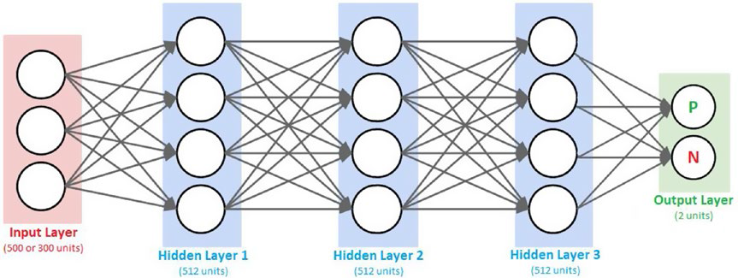
Support Vector Machine- Explained
Fully Connected DNN– Sentiment Analysis
Notes:
https://nlp.stanford.edu/projects/glove
We will be using the word2vec and GloVe models to generate embeddings. The word2vec model was built by Google. We will be choosing the size parameter to be 500 in this scenario representing feature vector size to be 500 for each word. We will be using the document word vector averaging scheme on this model to represent each movie review as an averaged vector of all the word vector representations for the different words in the review.
The GloVe model, which stands for Global Vectors, is an unsupervised model for obtaining word vector representations. Created at Stanford University, this model is trained on various corpora like Wikipedia, Common Crawl, and Twitter and corresponding pre-trained word vectors are available that can be used for our analysis needs. You can refer to the original paper by Jeffrey Pennington, Richard Socher, and Christopher D. Manning. 2014, called GloVe: Global Vectors for Word Representation, for more details. The spacy library provided 300-dimensional word vectors trained on the Common Crawl corpus using the GloVe model. They provide a simple standard interface to get feature vectors of size 300 for each word as well as the
averaged feature vector of a complete text document. The following snippet leverages spacy to get the GloVe embeddings for our two datasets. Do note that you can also build your own GloVe model by leveraging other pre-trained models or by building a model on your own corpus by using the resources available at https://nlp.stanford.edu/projects/glove which contains pre-trained word embeddings, code and examples.

Slide 12
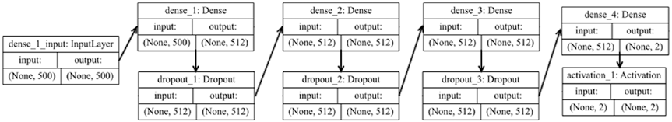
Support Vector Machine- Explained
Visualizing the DNN– Sentiment Analysis
Notes:
https://arxiv.org/pdf/1412.6980v8.pdf
We call this a fully connected deep neural network (DNN) because neurons or units in each pair
of adjacent layers are fully pairwise connected. These networks are also known as deep artificial neural
networks (ANNs) or Multi-Layer Perceptrons (MLPs) since they have more than one hidden layer. The
following function leverages keras on top of tensorflow to build the desired DNN model.
From the preceding function, you can see that we accept a parameter num_input_features, which
decides the number of units needed in the input layer (500 for word2vec and 300 for glove features). We
build a Sequential model, which helps us linearly stack our hidden and output layers.
We use 512 units for all our hidden layers and the activation function relu indicates a rectified linear
unit. This function is typically defined as relu(x ) =max(0,x ) where x is typically the input to a neuron. This
is popularly known as the ramp function also in electronics and electrical engineering. This function is
preferred now as compared to the previously popular sigmoid function because it tries to solve the vanishing
gradient problem. This problem occurs when x > 0 and as x increases, the gradient from sigmoids becomes
really small (almost vanishing) but relu prevents this from happening. Besides this, it also helps with faster
convergence of gradient descent. We also use regularization in the network in the form of Dropout layers. By
adding a dropout rate of 0.2, it randomly sets 20% of the input feature units to 0 at each update during
training the model. This form of regularization helps prevent overfitting the model.
The final output layer consists of two units with a softmax activation function. The softmax function is
basically a generalization of the logistic function we saw earlier, which can be used to represent a probability
distribution over n possible class outcomes. In our case n = 2 where the class can either be positive or
negative and the softmax probabilities will help us determine the same. The binary softmax classifier is also
interchangeably known as the binary logistic regression function.
The compile(...) method is used to configure the learning or training process of the DNN model
before we actually train it. This involves providing a cost or loss function in the loss parameter. This will be
the goal or objective which the model will try to minimize. There are various loss functions based on the
type of problem you want to solve, for example the mean squared error for regression and categorical crossentropy
for classification. Check out https://keras.io/losses/ for a list of possible loss functions.
We will be using categorical_crossentropy, which helps us minimize the error or loss from the
softmax output. We need an optimizer for helping us converge our model and minimize the loss or error
function. Gradient descent or stochastic gradient descent is a popular optimizer. We will be using the adam
optimizer which only required first order gradients and very little memory. Adam also uses momentum
where basically each update is based on not only the gradient computation of the current point but also
includes a fraction of the previous update. This helps with faster convergence. You can refer to the original
paper from https://arxiv.org/pdf/1412.6980v8.pdf for further details on the ADAM optimizer. Finally,
the metrics parameter is used to specify model performance metrics that are used to evaluate the model
when training (but not used to modify the training loss itself ). Let’s now build a DNN model based on our
word2vec input feature representations for our training reviews.

Slide 13
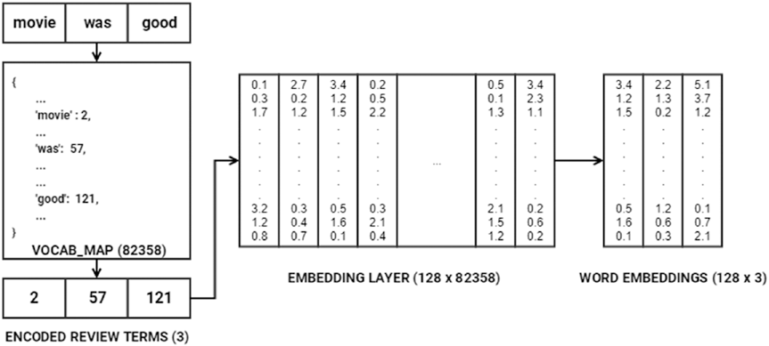
Support Vector Machine- Explained
Advanced Supervised Deep Learning Model – Understanding how word – embedding are generated
Notes:
https://arxiv.org/pdf/1412.6980v8.pdf

